Slide 1
MY NATURALIST BADGE By zoe 21.4.20 tuesday

Slide 2
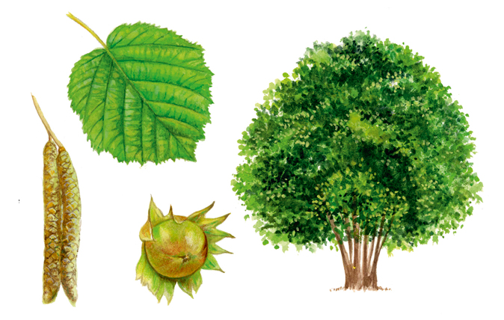
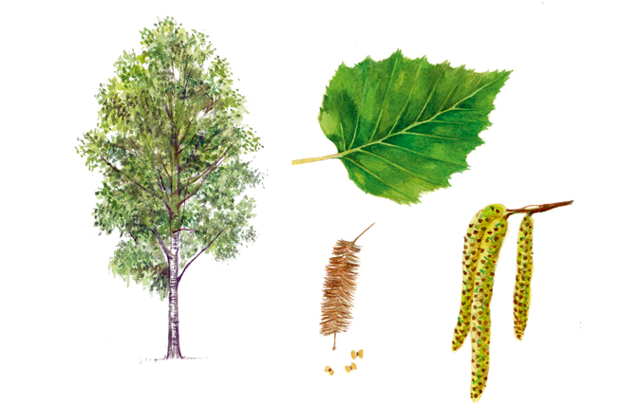
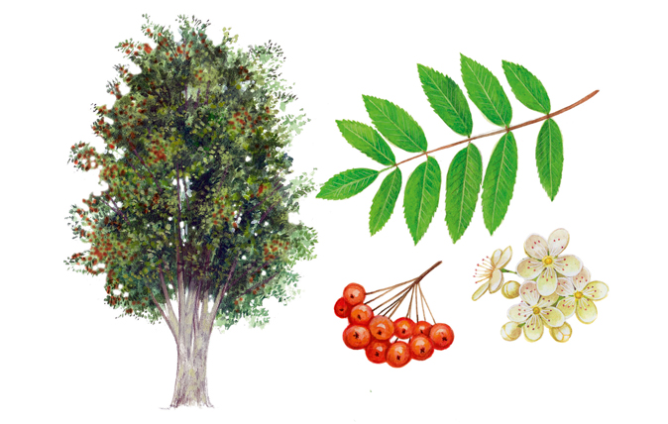
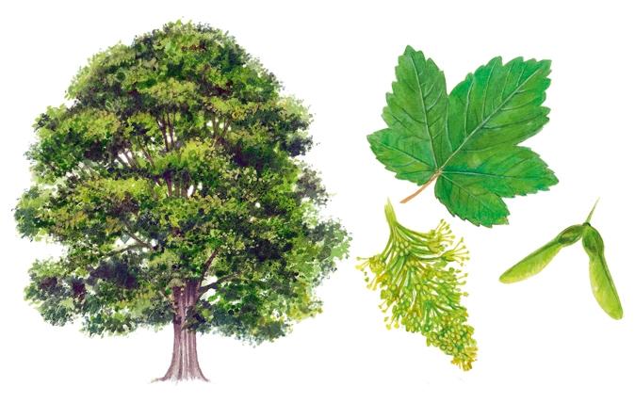
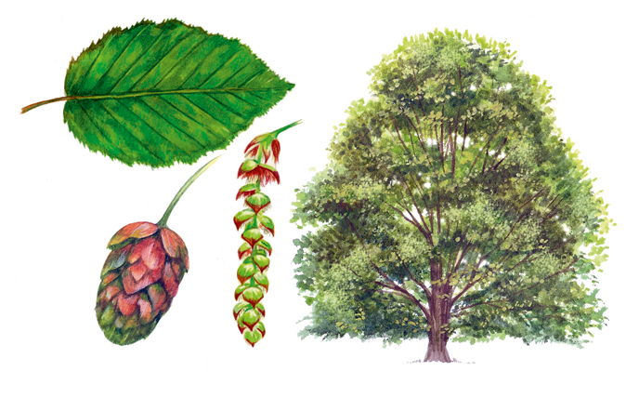
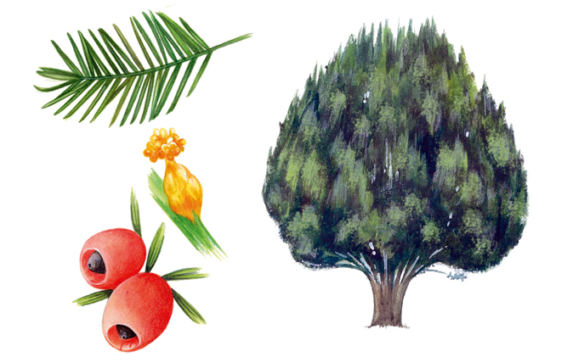
TREES
SILVER BIRCH
You can recognise Silver Birch by…
Country life
- Has a slender trunk and white bark
- Red-brown twigs that droop down
- In Winter, the branches radiate a purple hue
COMMON HAZEL
You can recognise the Hazel by…
SYCAMORE
ROWAN
- Has winged fruits
You can recognise Rowan by…
- Long, yellow catkins
- Dark green leathery-like toothed leaves
- Tiny flowers tipped by red stigmas
Smooth grey-brown bark-
- Green-yellow flowers and leaves appear in May and June
- Clusters of four brown nuts
- Has white blossom in May
- Jagged-edged green bracts
YEW
You can recognise Yew by…
- Red berrylike substance called Aril
- Small, ramrod straight needles
HORNBEAM
- Has green-winged fruits called Samaras
You can recognise Hornbeam by…
- Has clusters of triangular, ribbed nutlets
- Flowers appear in March and April
- The buds of the twigs lie flat

Slide 3
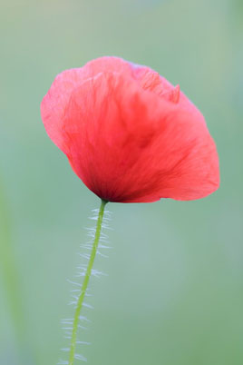
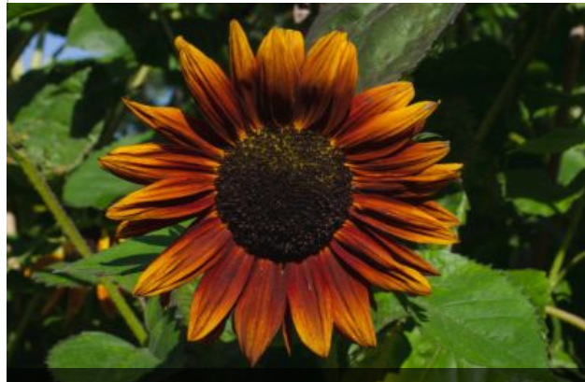
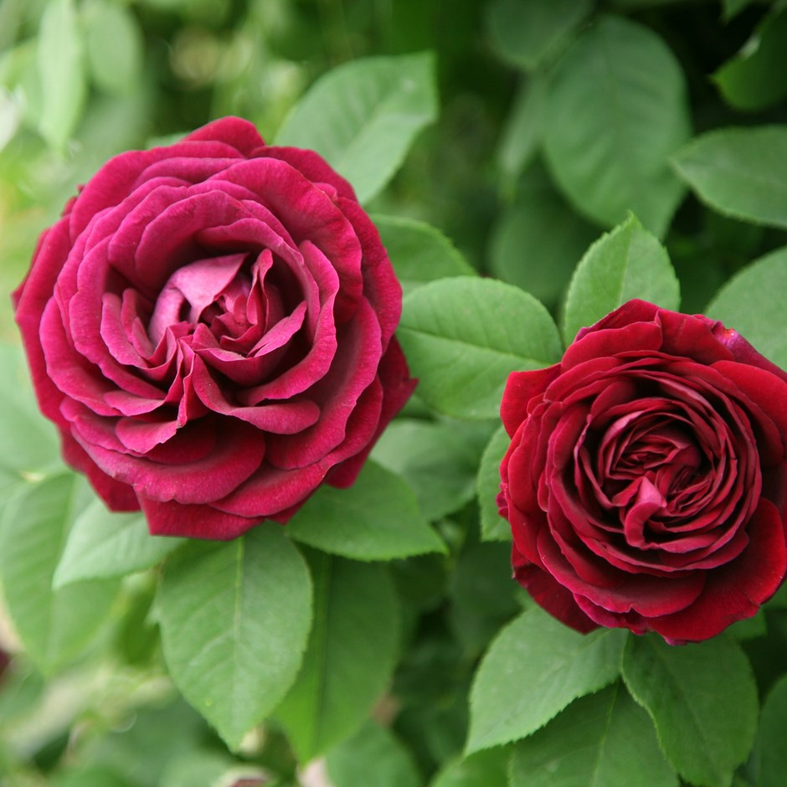
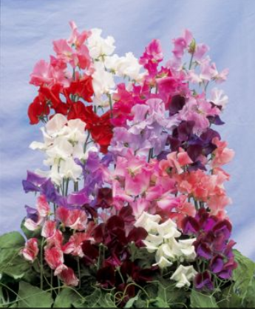
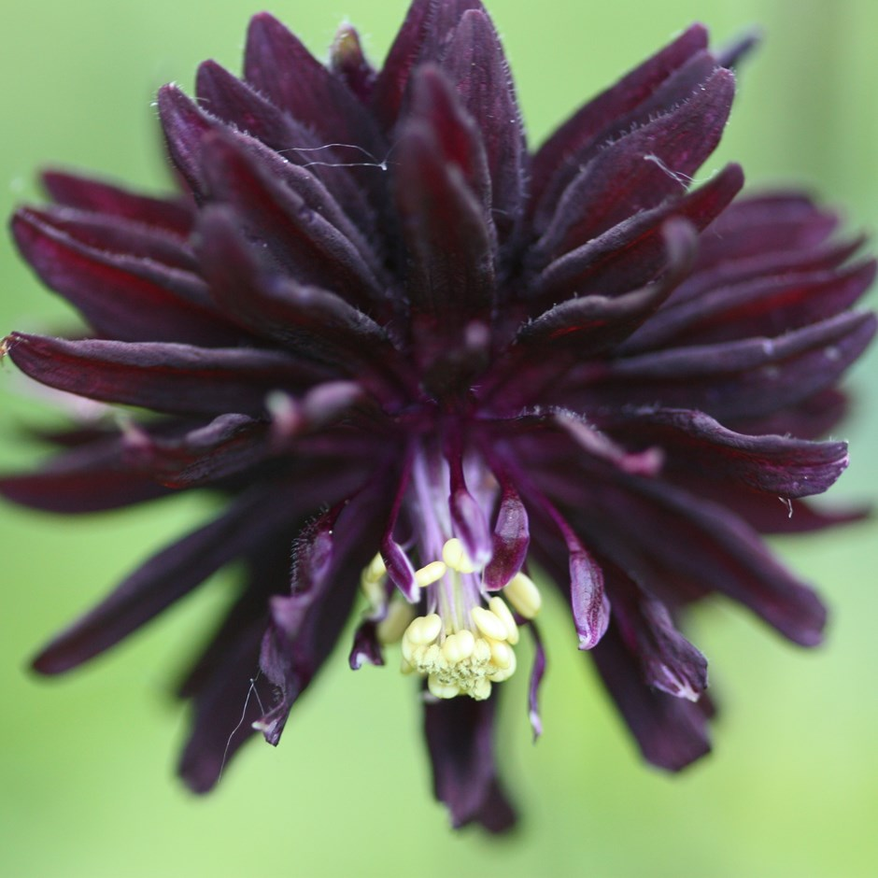
FLOWERS
COMMON POPPY
- Bright scarlet bowl-shaped flowers
SUNFLOWER
- Coarse green leaves
RHS
- Lobed, oblong leaves
- Ray florets
- Dark brown centers
SWEET PEAS
ROSE
- Loses all its leaves in Autumn
- Purple wings and keels
- Have a few thorns
- Dark or light red
- Red standard petals
BLACK PERENNIAL
TULIP
- Purple-black colour
Goblet-shaped flowers
- Fully double, spur-less flowers
- Yellow blotch at the base
- Fern-like leaves

Slide 4
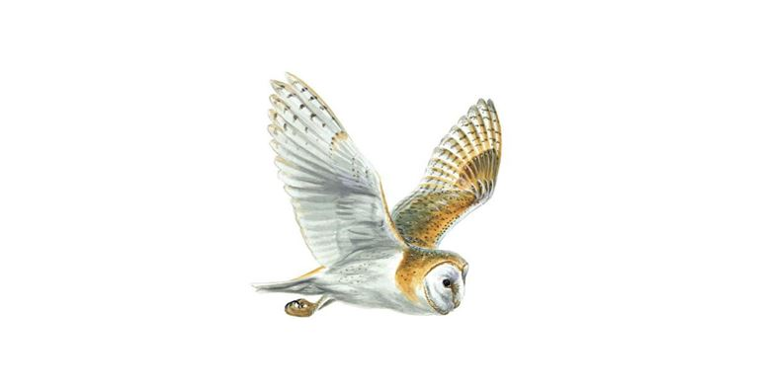
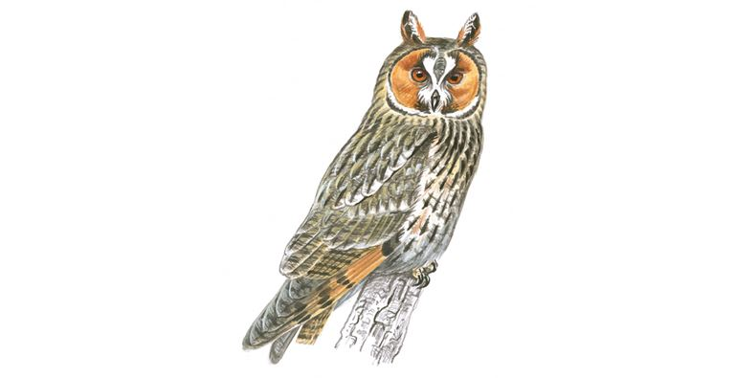
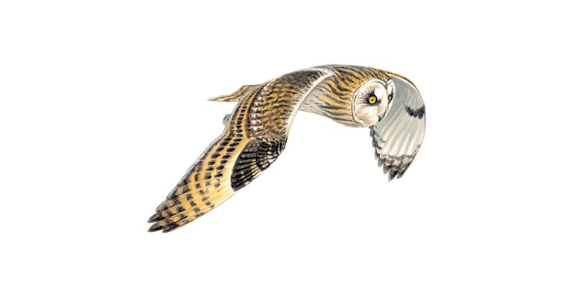
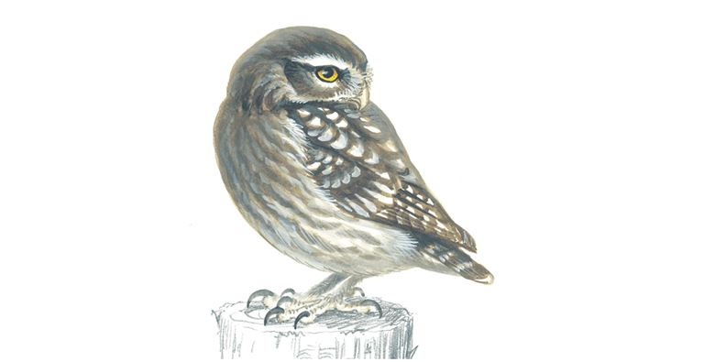
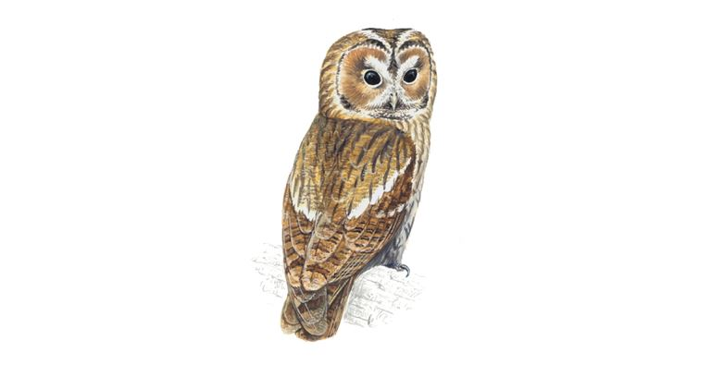
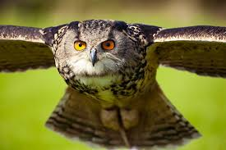
BIRDS
BARN OWL
- White heart-shaped face
RSPB
- Buff back and wings
LONG-EARED OWL
- White underparts
- Long and thin with head feathers
SHORT-EARED OWL
- Buff brown
- Mottled brown bodies
-Smaller than a woodpidgeon
- Pale wings
LITTLE OWL
- Yellow eyes
- Bobs its head when it is alarmed
Size of a woodpidgeon
TAWNY OWL
- Rounded wings
- Round head and body
- Rapid wingbeats
- Dark feathers around dark eyes
EAGLE OWL
- Large wingspan
- Orange eyes
- Tufts of feathers on their head

Slide 5
THANK YOU FOR WATCHING
I hope you enjoyed it

